Slide 1
AI-BASED VIOLENCE DETECTION AND ALERTING MANAGEMENT SYSTEM
TEAM MEMBERS
RAJENDRAPRASATH M
810022104104
GUIDED BY

Slide 2
INTRODUCTION
Public safety is a major concern in urban and industrial environments.
Manual monitoring of surveillance cameras:
Is time-consuming
Prone to human error
Delays emergency response
This project develops an AI-based violence detection system that:
Automatically analyzes video footage
Detects violent activities
Generates real-time alerts
Provides admin dashboard and analytics

Slide 3
PROBLEM STATEMENT
Current surveillance systems face several limitations:
Depend heavily on continuous human monitoring
Lack automated violence detection capabilities
Do not provide real-time alert mechanisms
Fail to maintain centralized incident reporting and analytics
Cannot scale efficiently for large surveillance networks
As a result, violent incidents may go unnoticed or response may be delayed.

Slide 4
OBJECTIVES
• Develop an AI model to classify violence and non-violence • Build a multi-camera web dashboard • Implement real-time alert notification system • Store historical data for analysis • Integrate Salesforce for reporting and analytics

Slide 5
EXISTING WORK
Spatio-Temporal Deep Learning Models Example: Multi-scale CNN-based violence detection Focus only on model accuracy
IoT-Based Surveillance Systems Focus on edge devices Limited dashboard integration
Traditional CCTV Monitoring Manual supervision No automation
Limitations:
No complete management system
No enterprise-level reporting
No integrated alert dashboard

Slide 6
PROPOSED SYSTEM
Develop an End-to-End AI Surveillance Management System
System Includes:
• Video input from multiple cameras • Backend processing pipeline • Vision Transformer (ViT) model • Real-time alert triggering • Admin monitoring dashboard • Salesforce analytics integration

Slide 7
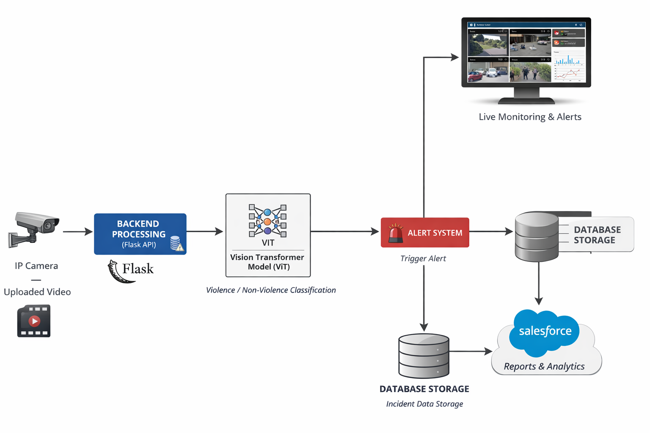
SYSTEM ARCHITECTURE

Slide 8
SYSTEM WORKFLOW
Step 1: User uploads/selects video from dashboard Step 2: Backend extracts video frames Step 3: Vision Transformer model classifies frames Step 4: Calculate average violence probability Step 5: If violence detected → Trigger alert Step 6: Store incident data Step 7: Generate reports in Salesforce

Slide 9
MODEL DETAILS
Model Used: Google Vision Transformer (ViT)
Why ViT?
• Strong image classification performance • Captures global image features • Efficient for frame-based classification • Pretrained and fine-tuned for violence detection

Slide 10

Dataset Details

Slide 11
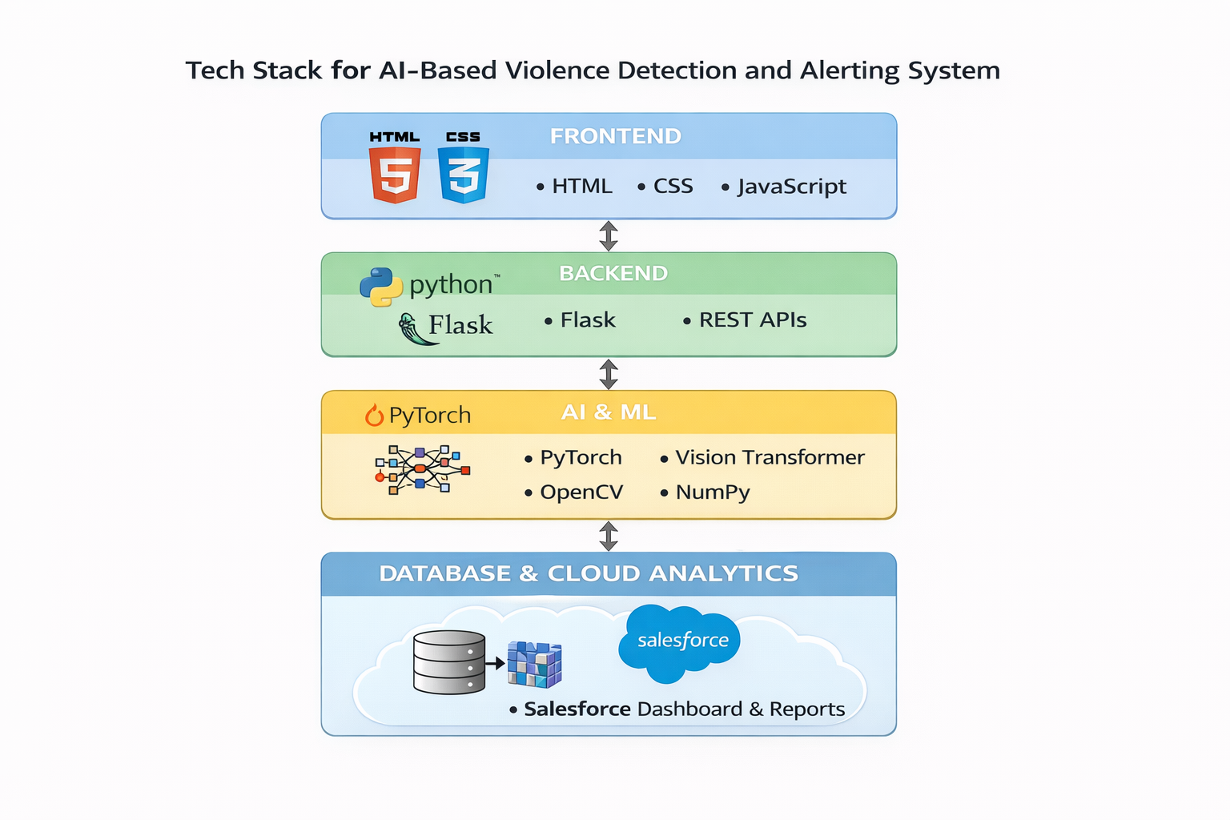
SOFTWARE REQUIREMENTS

Slide 12
Comparison with Existing Work

Slide 13
HARDWARE REQUIREMENTS
• Personal Computer • GPU (optional for faster inference) • Webcam / Video files • Internet (for Salesforce integration)

Slide 14
ALERTING SYSTEM
When violence probability exceeds threshold:
• Alert generated instantly • Admin dashboard notification • Incident stored in database • Report sent to Salesforce
This ensures quick response and monitoring.

Slide 15
SALESFORCE ANALYTICS
Features:
• Violence incident count • Date-wise reports • Camera-wise analysis • Trend visualization • Historical data tracking
Provides decision support for authorities.

Slide 16
RESULTS
COMPARISON WITH EXISTING PAPERS
Feature | Research Papers | Our Project
Model | Yes | Yes
Real-Time Alert | Limited | Yes
Web Dashboard | No | Yes
Admin Panel | No | Yes
Analytics | No | Salesforce Integration
Full System Implementation | No | Yes

Slide 17
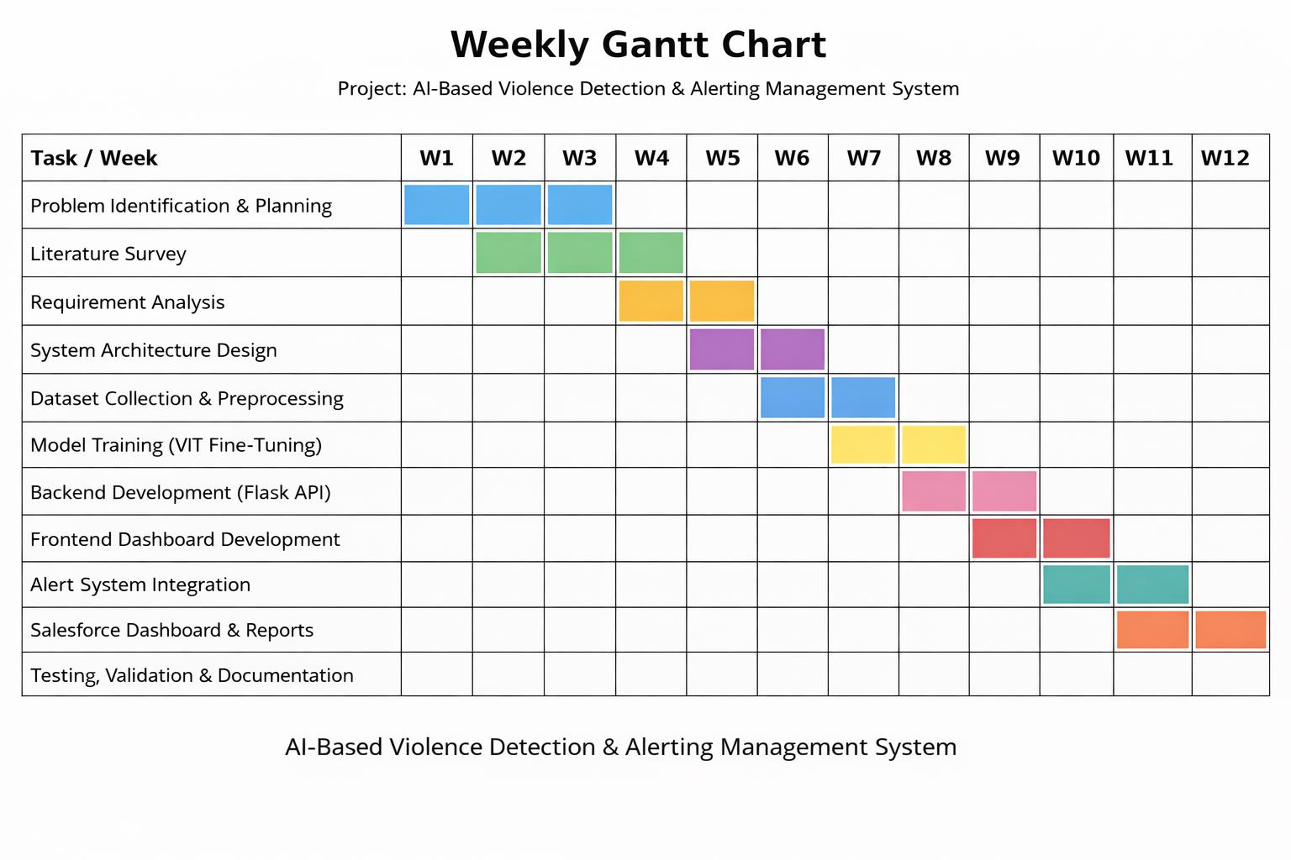

Slide 18
CONCLUSION
An AI-based violence detection and alerting management system was successfully developed.
The system:
• Detects violence using Vision Transformer • Generates real-time alerts • Provides centralized monitoring dashboard • Stores historical data • Enables analytical reporting using Salesforce
This project bridges the gap between AI research and practical surveillance system deployment.

Slide 19
FUTURE ENHANCEMENTS
• Live CCTV integration • Spatio-temporal model upgrade • Edge deployment • SMS / Email alert system • Mobile application integration

Slide 20
THANK YOU

